Slide 1
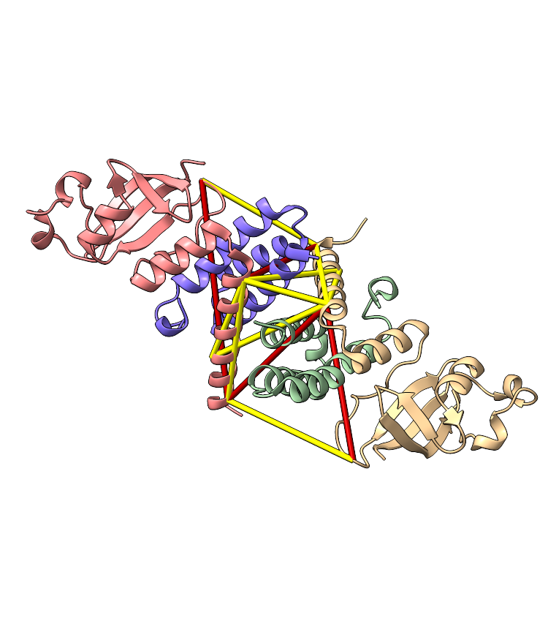
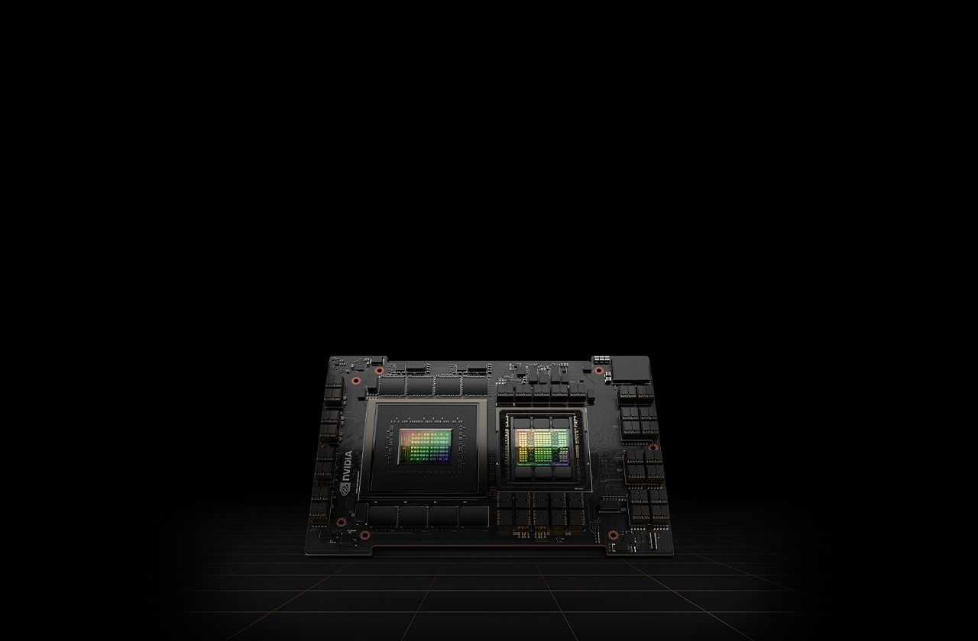
Solving big problems on small computers
alternative title: Proteome-wide Non-Cleavable Crosslink Identification Using Sparse Matrix Multiplication with MS Annika 3.0
Micha Birklbauer, September 2024

Slide 2
Introduction: Cross-linking
Protein A
Crosslinker: Small molecule that covalently links amino acids in or between proteins
Digestion
Smaller connected fragments → α Peptide and β Peptide
Analyzed with mass spectrometry
Used for structure analyses and to study protein-interaction networks
Crosslinker
Protein B
Digestion
α Peptide
β Peptide
Notes:
Very basic:
You have your sample with your proteins in it
You add your crosslinker
You digest it
You get theses smaller connected fragment called alpha and beta peptide
They are analyzed on the mass spectrometer

Slide 3
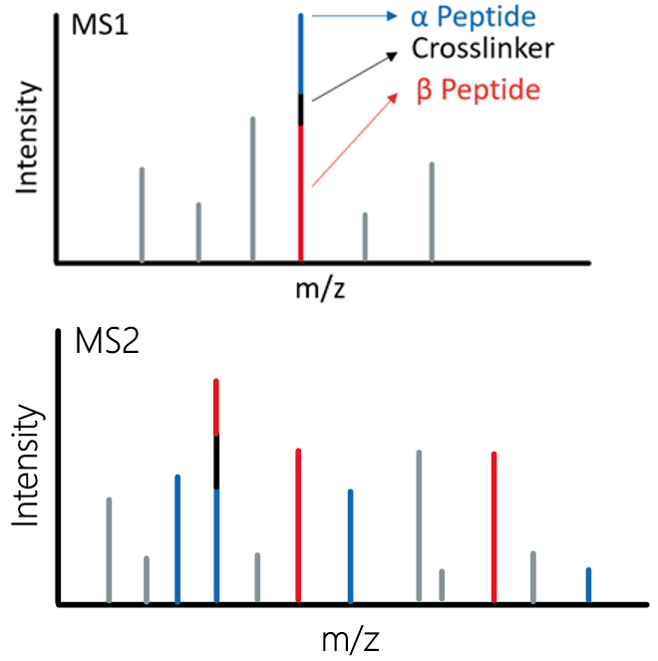
The Problem
In non-cleavable cross-linking experiments we cannot infer the masses of the two individual peptides
We know the mass of the complete cross-linked entity (precursor)
For identification we need to consider any combination of two peptides that make up the precursor mass

Slide 4

The n² Problem
Considering every combination of peptides leads to very large search spaces
Consider a database of n peptides, the number of possible combinations c would be:
$c=\left(\begin{matrix}n \\ 2\end{matrix}\right)+n=\left(n+1\right)∗ \frac{n}{2}$
For big n this can be considered O(n²) complexity
For the human proteome (SwissProt, 20 337 p), trypsin digest, maximum 3 missed cleavages, 5 – 30 peptide length:
n = 2 749 058
c = 3 778 661 318 211
one combination = 16 bytes
Total = ?

Slide 5

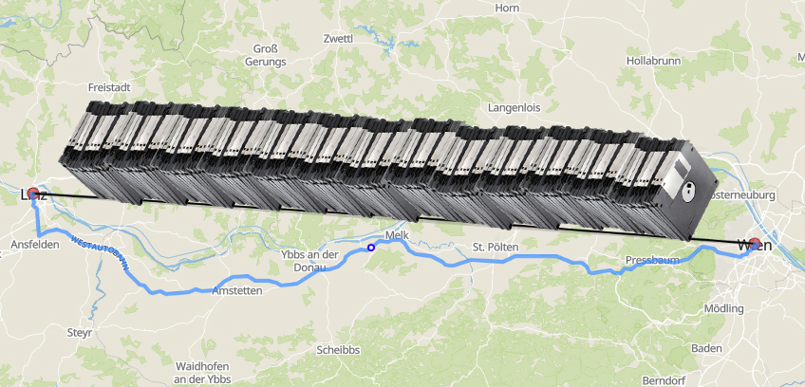
54.98676 TB
This would roughly fit on three enterprise-level hard disks
Or on enough 3.5“ floppy disks to cover the distance from Linz to Vienna

Slide 6

Tackling the n² Problem
Three different options:
Cry
Reducing the search space
Speeding up the search process so more combinations can be considered
source: giphy.com

Slide 7
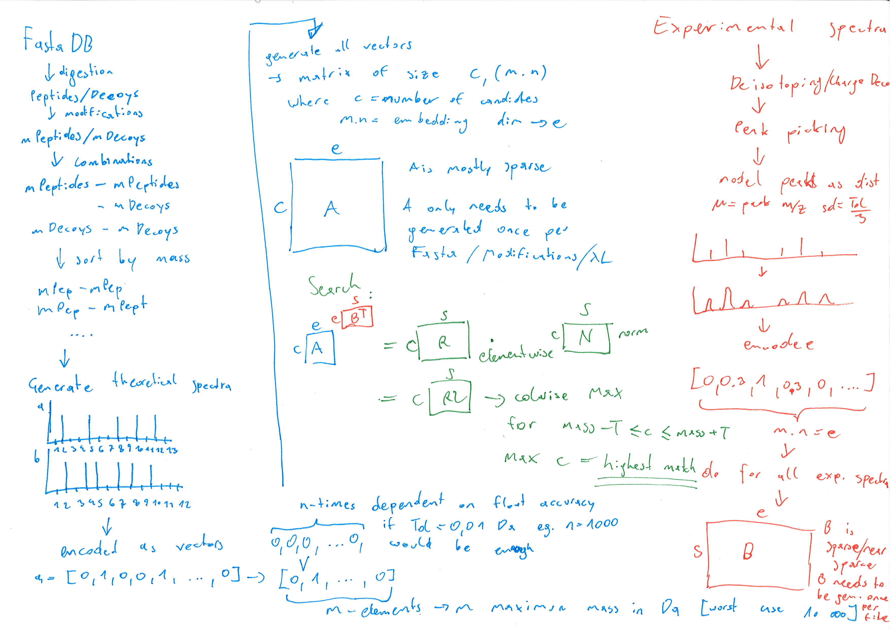
The Idea
Reduction of search space:
Identify one of two peptides first
→ Limits the number of combinations to consider
Identification of the peptide by a fast approximate search:
Encoding of peptides and spectra as sparse vectors
Scoring purely based on addition and multiplication
Adhering to the SIMD paradigm

Slide 8


MS Annika 3.0
input
encoding
output
mass spectra
intensity
m/z
scan | alpha | beta
1 | PEPK | TKDE
2 | PKEP | KDET
3 | KEPP | TIDK
0
1
0
1
1
0
identify potential alpha peptides with MS Amanda
scoring by multiplication
encoding
protein database
P E P T I D E
take highest scoring hits
0
1
0
1
1
0
create crosslinks from alpha and beta peptides that match precursor mass
identify complimentary beta peptides
in silico digestion
crosslinker

Slide 9
MS Annika 3.0
can be GPU accelerated
input
encoding
output
mass spectra
intensity
m/z
scan | alpha | beta
1 | PEPK | TKDE
2 | PKEP | KDET
3 | KEPP | TIDK
0
1
0
1
1
0
identify potential alpha peptides with MS Amanda
scoring by multiplication
encoding
protein database
P E P T I D E
take highest scoring hits
0
1
0
1
1
0
create crosslinks from alpha and beta peptides that match precursor mass
identify complimentary beta peptides
in silico digestion
crosslinker

Slide 10
The End Product
Quite literally…

Slide 11
Comparison of MS Annika 3.0 to Other Search Engines
Dataset by Beveridge et al. → PXD014337
Synthetic peptides cross-linked with DSS
→ allows calculation of “true“ FDR
→ allows assessment of which crosslinks are true positive identifications and which are false positive identifications
Comparison against MaxLynx (MaxQuant), MeroX, pLink, xiSearch and XlinkX
Goal: Identify as many true positive crosslinks as possible while staying close to 1% FDR

Slide 12
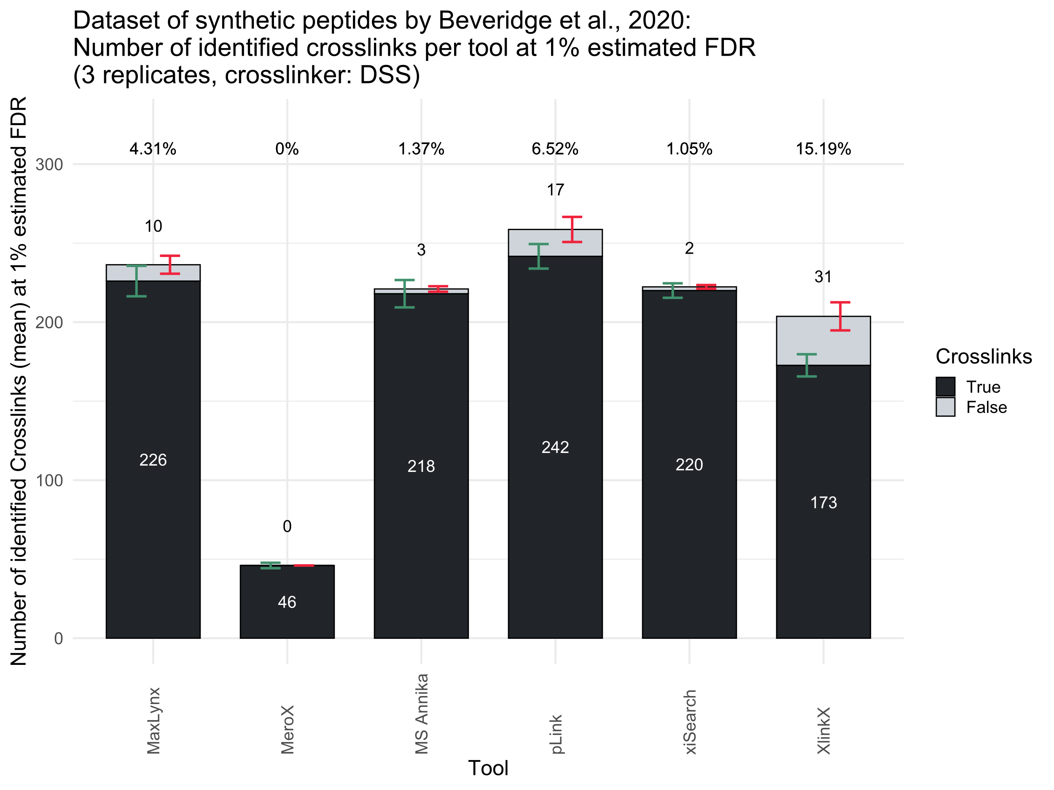

Slide 13
The Real Test: Large Scale Proteome-Wide Crosslink Identification
Mass spectra from C. elegans nuclei samples
Samples cross-linked with DSG
Comparison of two searches:
Searched against database of most abundant proteins (n ≈ 3000)
Searched against the full C. elegans proteome using all sequences available in UniProt (n ≈ 26 000)
Validated for 1% FDR with xiFDR

Slide 14
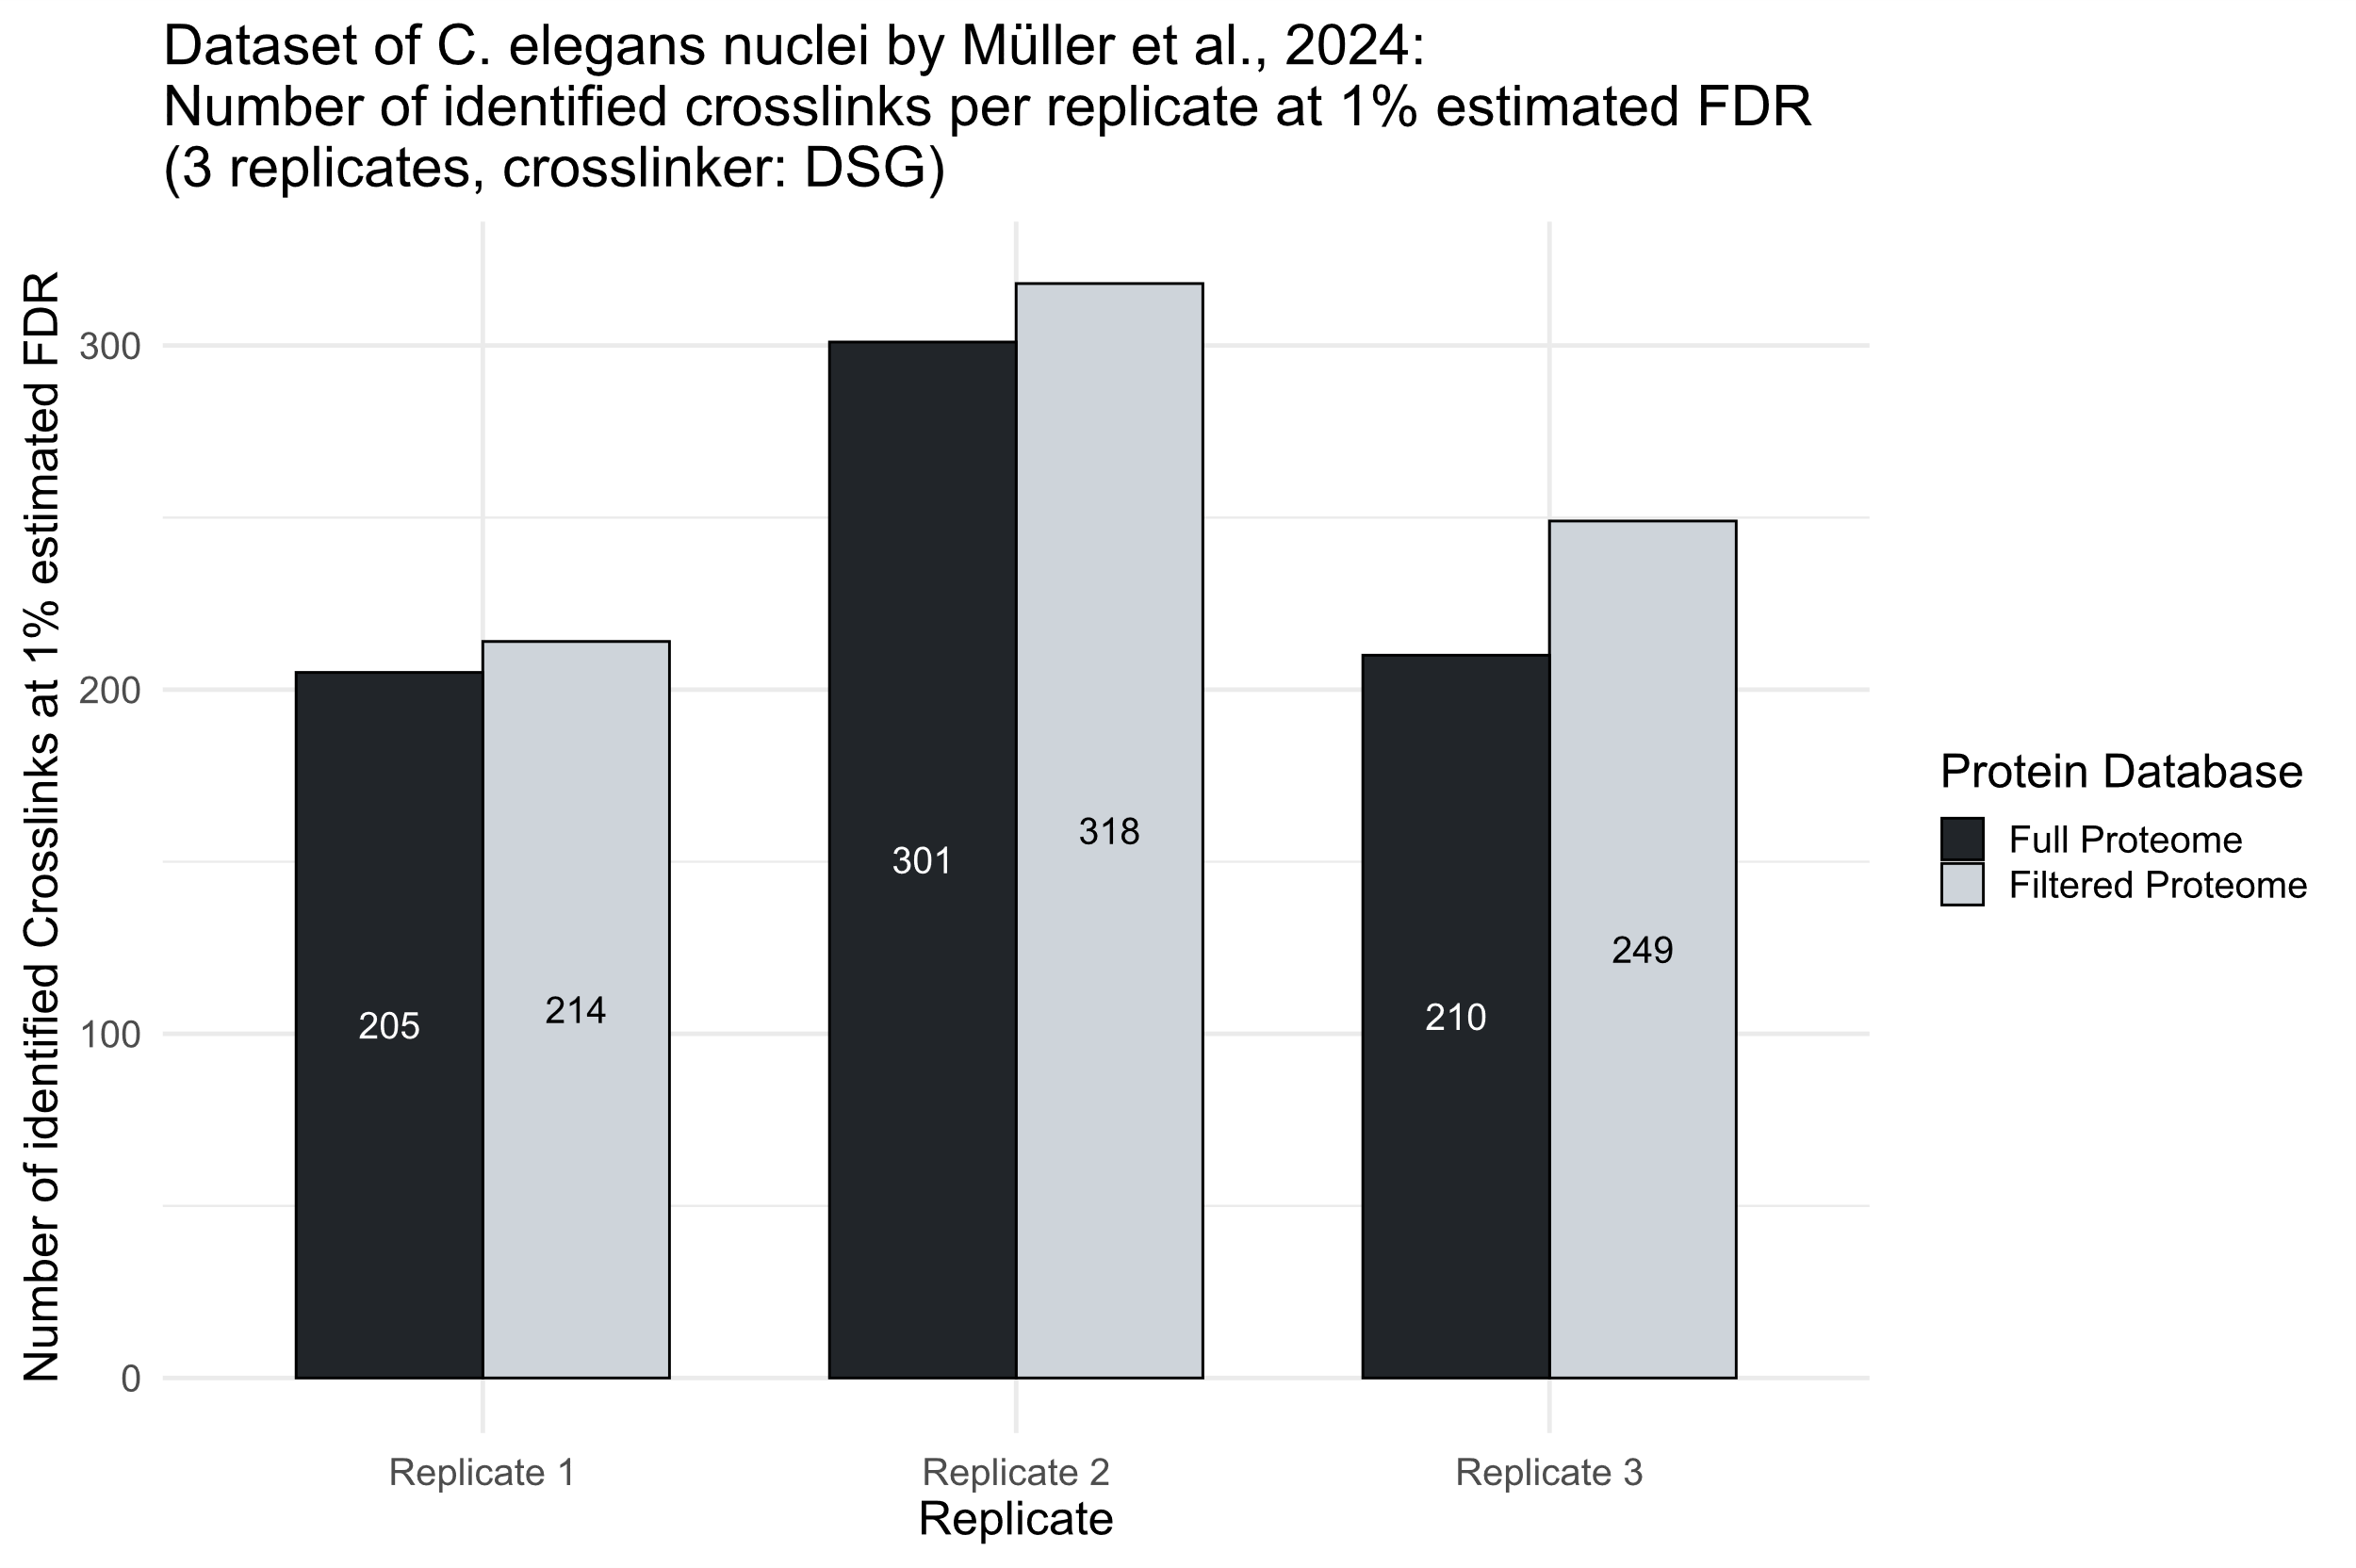

Slide 15
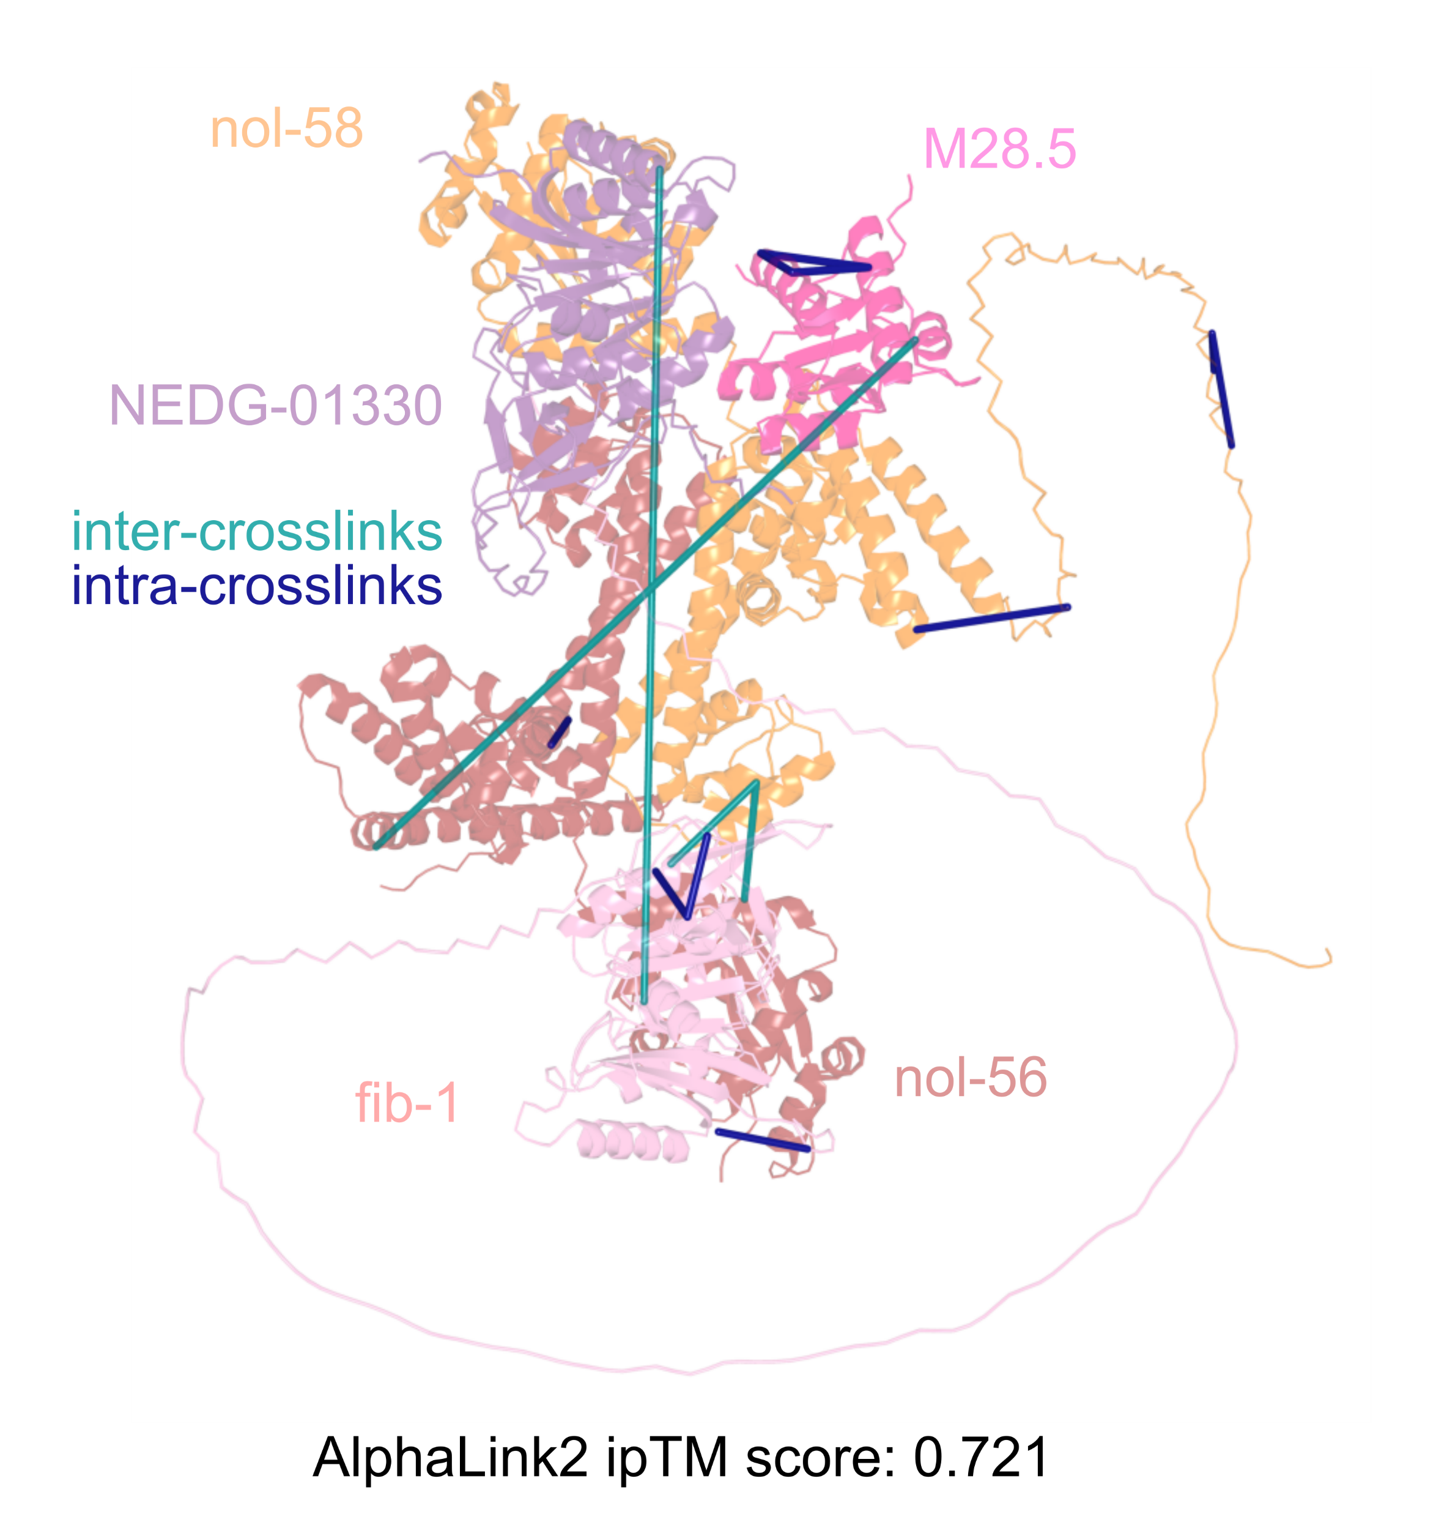
Refined structure of the Box C/D RNP complex in C. elegans

Slide 16
Conclusions
MS Annika 3.0 can successfully tackle proteome-wide non-cleavable crosslink studies
The implemented algorithm is super efficient, allowing proteome-wide searches on commodity hardware
This will allow researchers to:
Perform non-cleavable crosslink studies of complex samples that were previously unfeasible
Re-analyze published crosslink data with bigger protein databases, potentially uncovering new biological insights
The algorithm presents a transferable solution for big search space problems

Slide 17
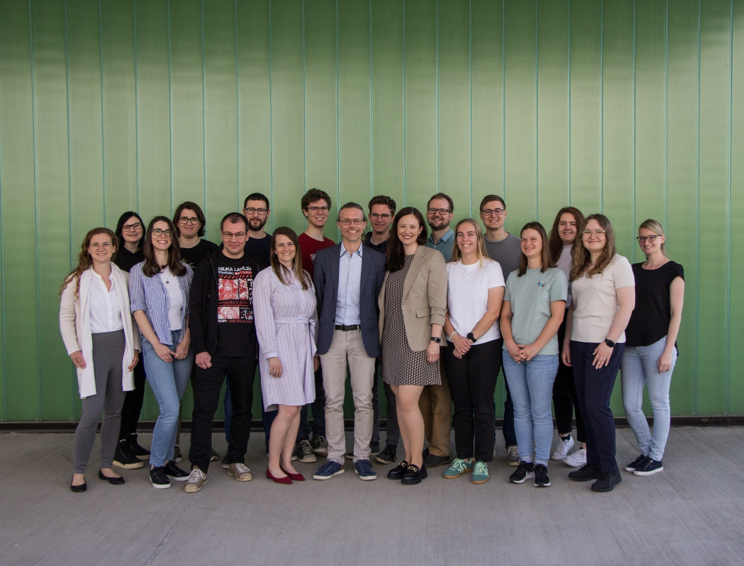



Acknowledgements
Fränze Müller, Sowmya Geetha, Manuel Matzinger & Karl Mechtler
Viktoria Dorfer
FWF
The Eigen developers & community
My research group 😊

Slide 18


Discussion
Pre-Print:
MS Annika:
github.com/hgb-bin-proteomics/ MSAnnika
Contact:
micha.birklbauer@fh-hagenberg.at
github.com/michabirklbauer
michabirklbauer.me
source: giphy.com

Slide 19
Appendix A
More Comparisons

Slide 20
Comparison of MS Annika 3.0 to Other Search Engines
Dataset by Matzinger et al. → PXD029252
Synthetic peptides cross-linked with ADH
→ allows calculation of “true“ FDR
→ allows assessment of which crosslinks are true positive identifications and which are false positive identifications
Comparison against MaxLynx (MaxQuant), MeroX, pLink, xiSearch and XlinkX
Goal: Identify as many true positive crosslinks as possible while staying close to 1% FDR

Slide 21
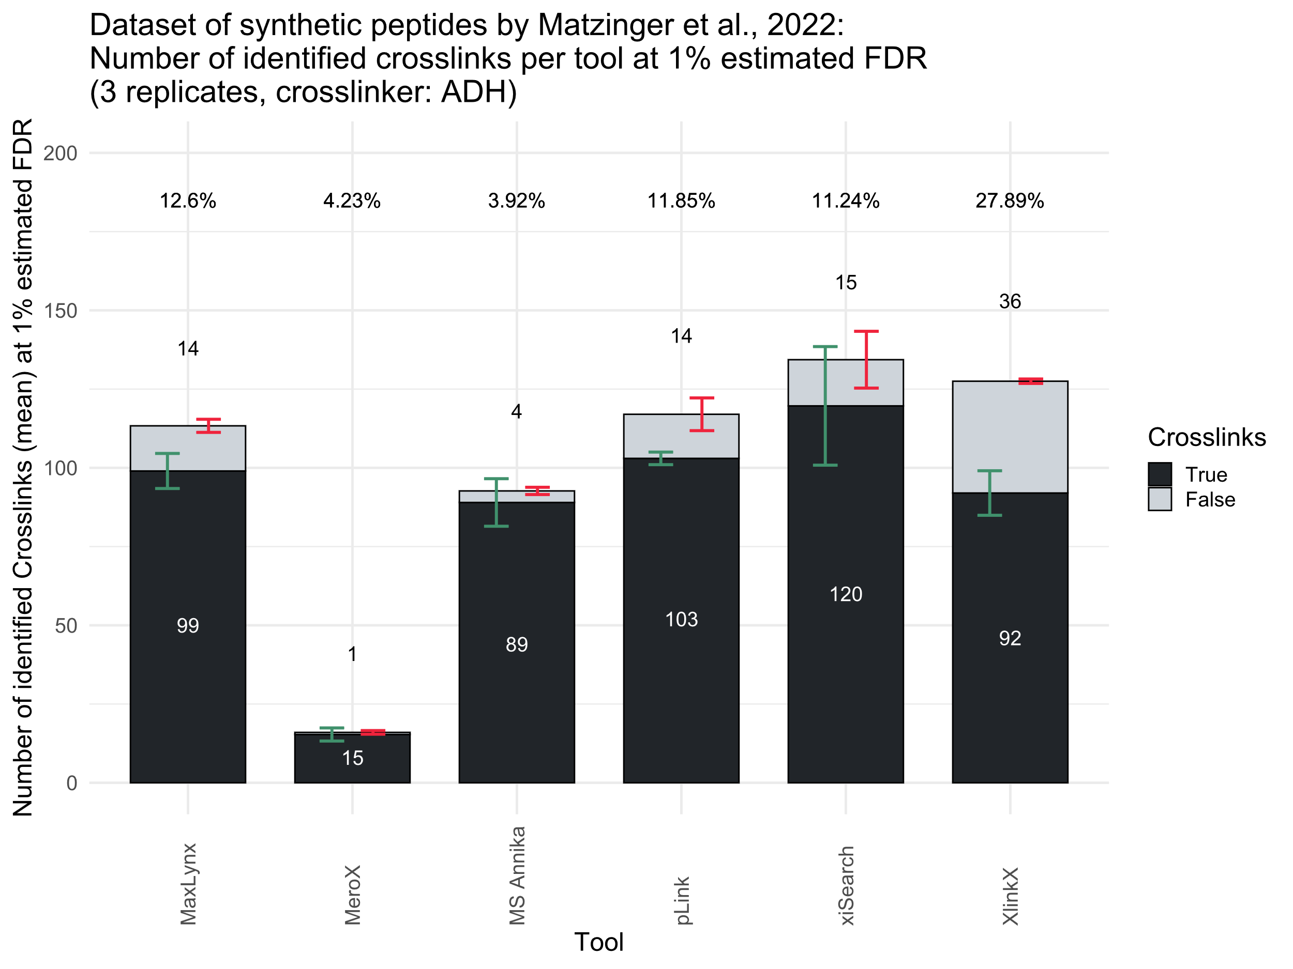

Slide 22
Appendix B
Matrix Encoding

Slide 23
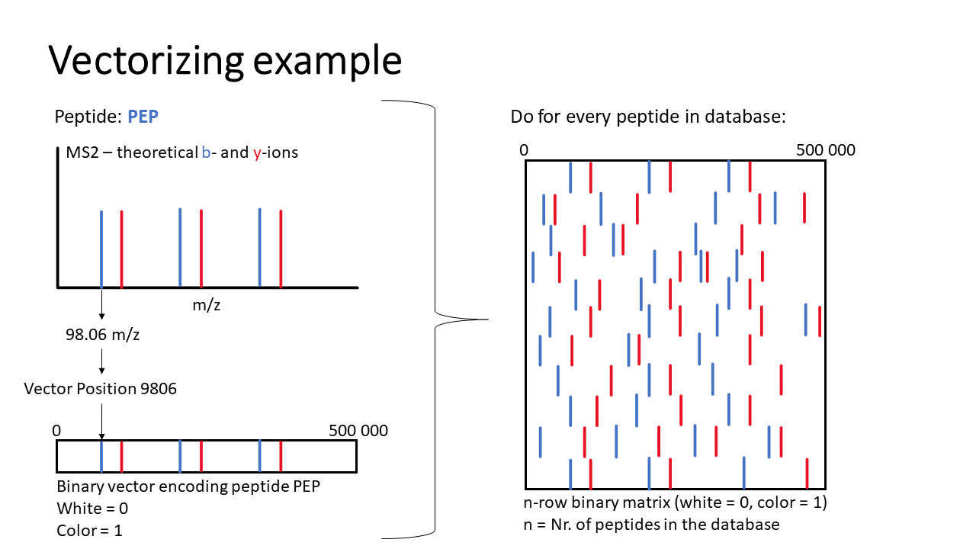

Slide 24
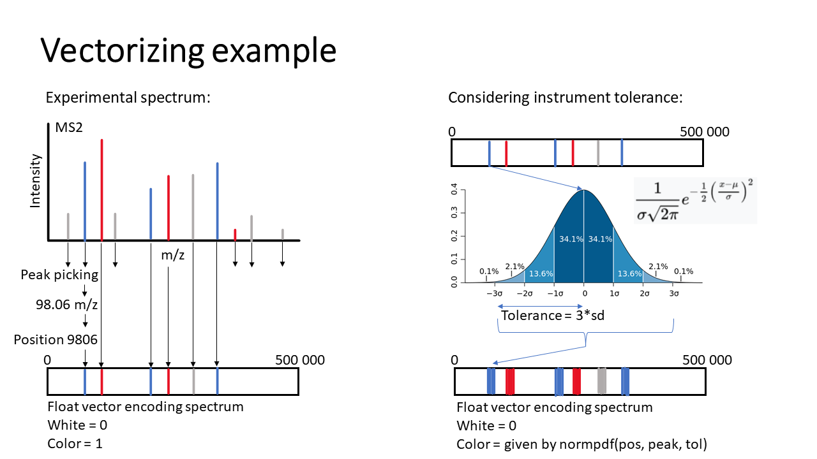

Slide 25
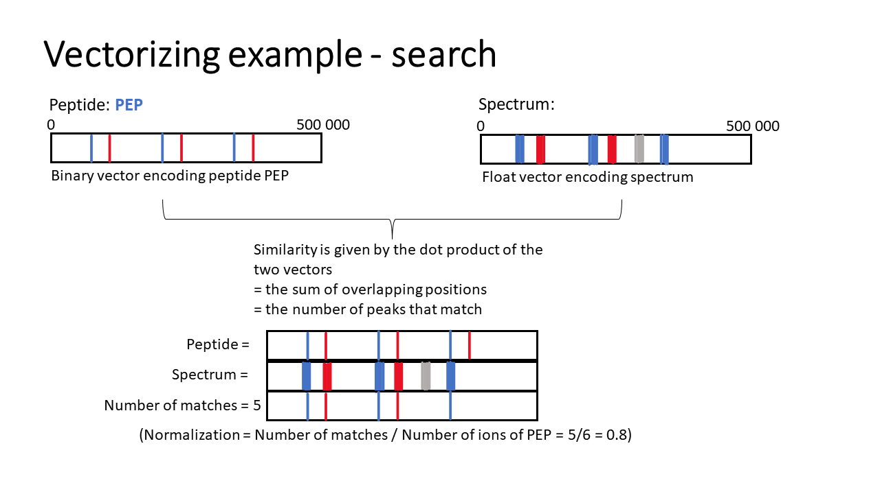

Slide 26
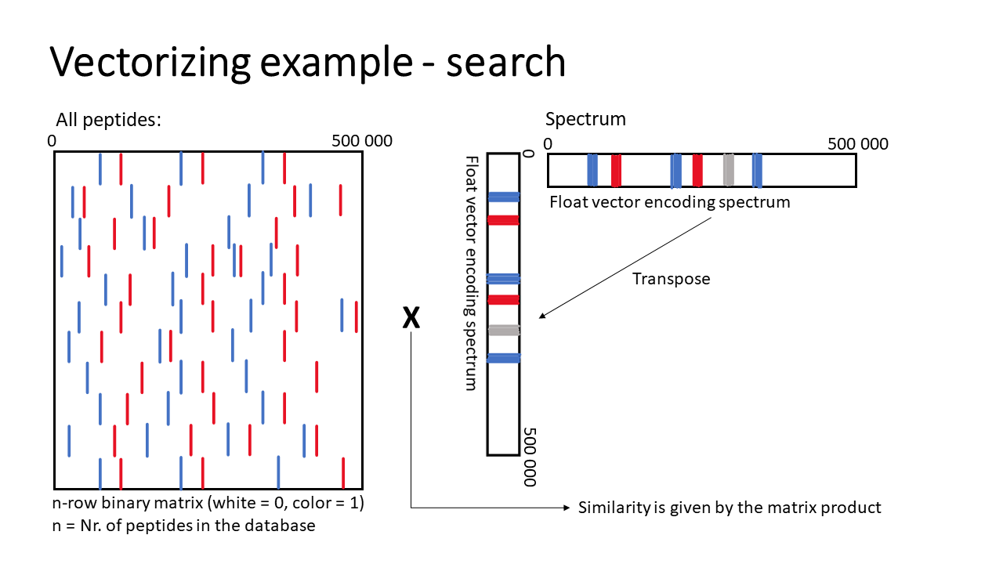

Slide 27
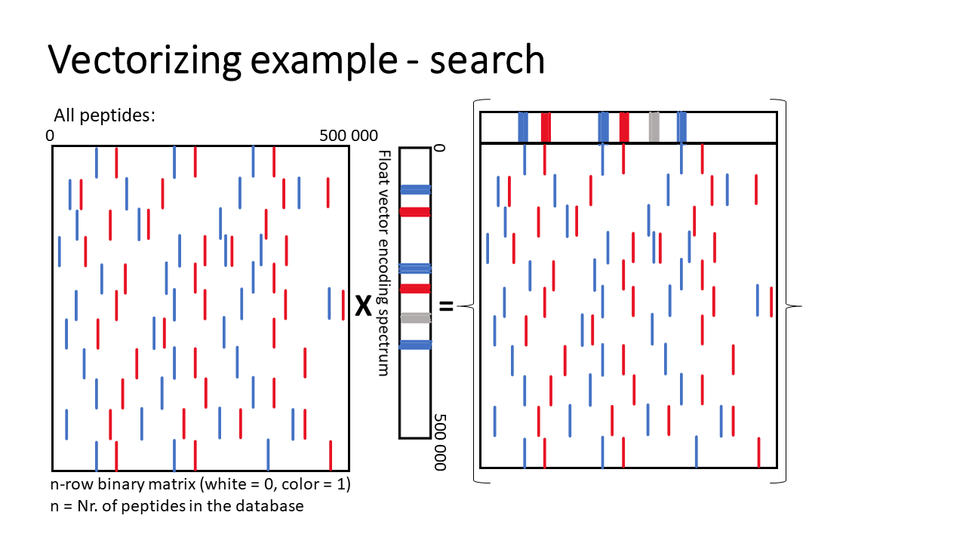

Slide 28
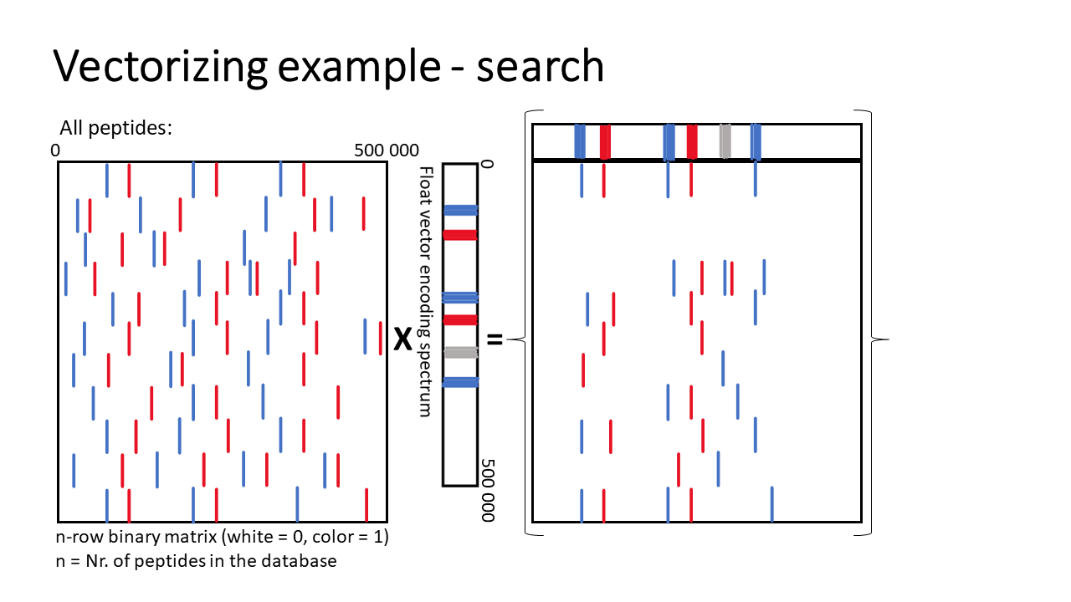

Slide 29
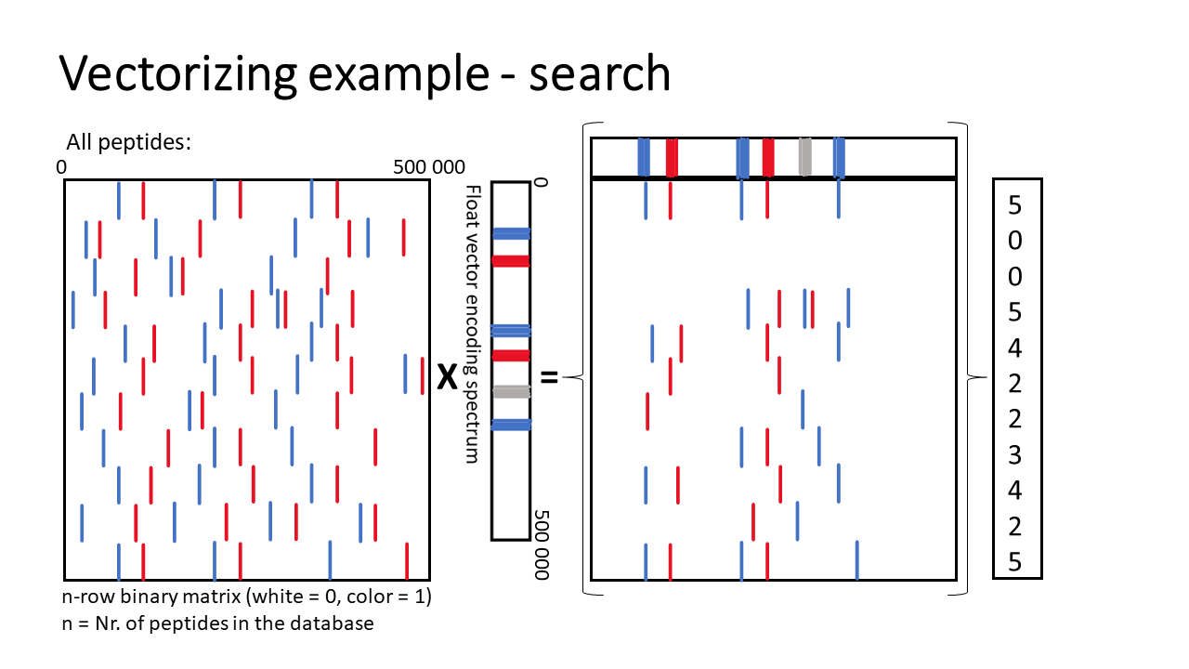

Slide 30
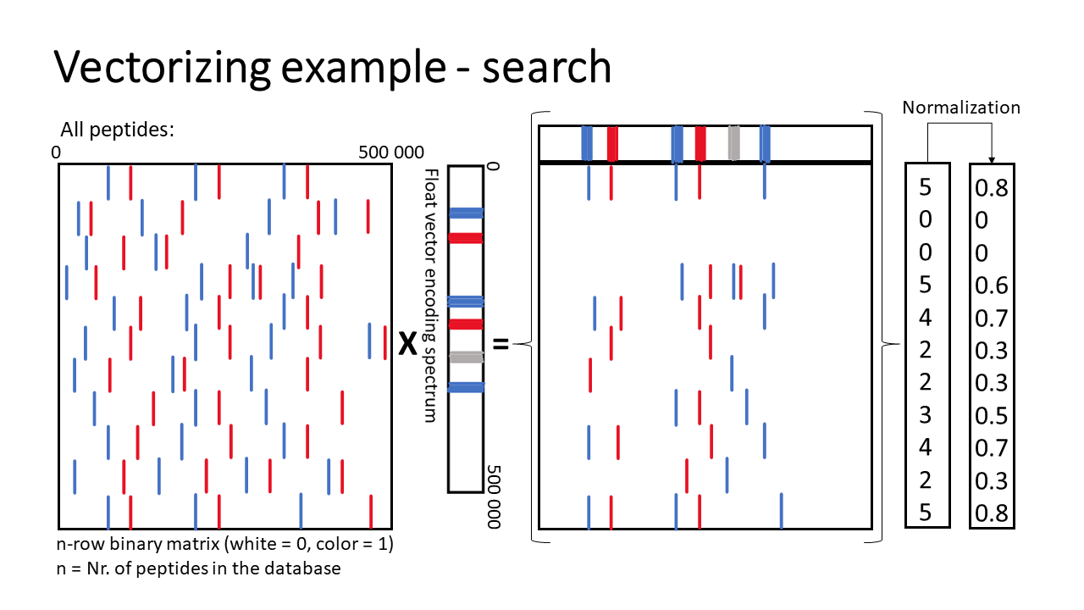

Slide 31
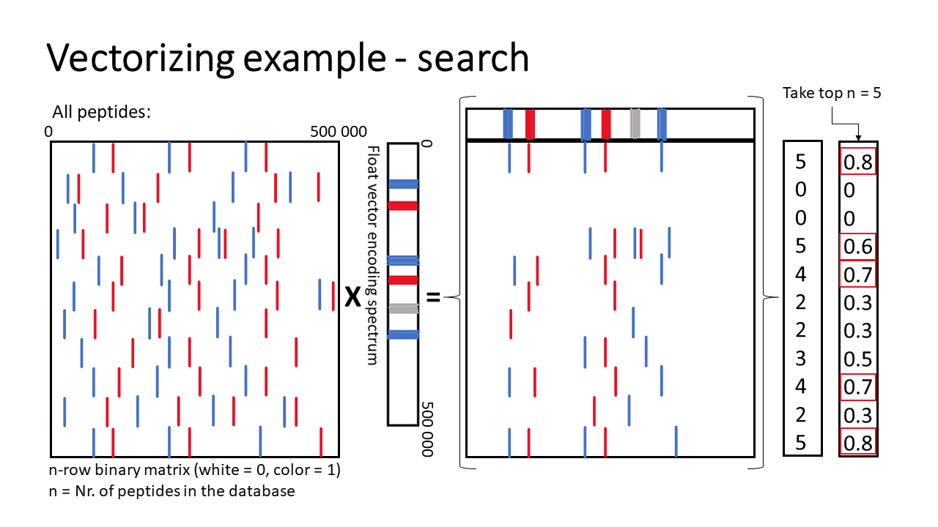

Slide 32
